Slide 1
Branding, Quality, and Openness: New Dimensions in Higher Education
Gary W. Matkin, Ph.D., Dean of Continuing Education
University of California, Irvine
“Branding in Higher Education: Practices and Lessons Learned from Global Perspectives. August 10-11, 2009

Slide 2
The Essential Elements for Institutional Success
Academic Quality
“Open”
Brand
Notes:
Brand, academic quality, and the degree to which an institution of higher education is “open” are interrelated dimensions. Although all three terms have a history in higher education, “brand” and “open” are relatively new in the vocabulary of its literature. This presentation will examine how and why the nomenclature has changed and particularly how these three concepts are interrelated and have become essential for institutional success.

Slide 3
Universities Have Strong Brand Images─Nationally and Internationally
Notes:
Here, the Dalai Lama dons a UC Irvine baseball hat.
Attempts to increase institutional brand recognition have long been a feature of the field, and, indeed, the current use of the term is symbolic of a deep, if subtle, shift in higher education. Institutions clearly compete for students, faculty, and financial resources. In the developed world, particularly in the U.S., institutions spend significant resources to capture the educational equivalent of market share.

Slide 4
Academy Award Nominated Actor, Leonardo DiCaprio Wearing a UC Irvine Hat
Notes:
Another example of how the UC Irvine brand has become “main-stream.”

Slide 5
Intercollegiate Athletics Feed Institutional Brand Identity and Drive Student Choice
Notes:
Some of the fiercest competition takes place in the U.S. market for student athletes, as successful intercollegiate athletic programs feed institutional brand identity and produce licensing revenue for the use of logos and, for instance, sports apparel.

Slide 6
International Movement from Elite to Mass Higher Education
Based on Martin Trow’s work in 1975
Elite Systems of Higher Ed
Offers University education to 5-10% of high school grads
Mass Systems of Higher Ed
Offers University education to over 30% of high school grads
Notes:
The international movement from elite higher education to mass education has overwhelmed the capacity of nation-states to provide free or low-cost higher education to those who can most benefit from it. (Trow, 1974).

Slide 7
The World’s Largest Open Universities
Rank | Institution | Location | Enrollment
1 | Indira Gandhi National Open University | New Delhi , India | 2 million
2 | Allama Iqbal Open University | Islamabad, Pakistan | 1.8 million
3 | Anadolu Univresity | Eskisehir, Turkey | 1.3 million
4 | Bangladesh Open University | Gazipur, Bangladesh | 600,000
5 | The Open University | United Kingdom | 180,000
6 | The Open University of Catalunya | Barcelona, Spain | 100,000
Notes:
For instance, India plans to increase its age participation rate (APR) from 10 percent to 15 percent by 2012, thereby serving 5,000,000 more students. (Daniel, Kanwar, Uvalic-Trumbic, 2009). Each year in Vietnam, about 200,000 or 20 percent of the 1,000,000 high school graduates go to a college or university.
This slide shows the shocking enrollment figures for the “Mega-Universities.”

Slide 8
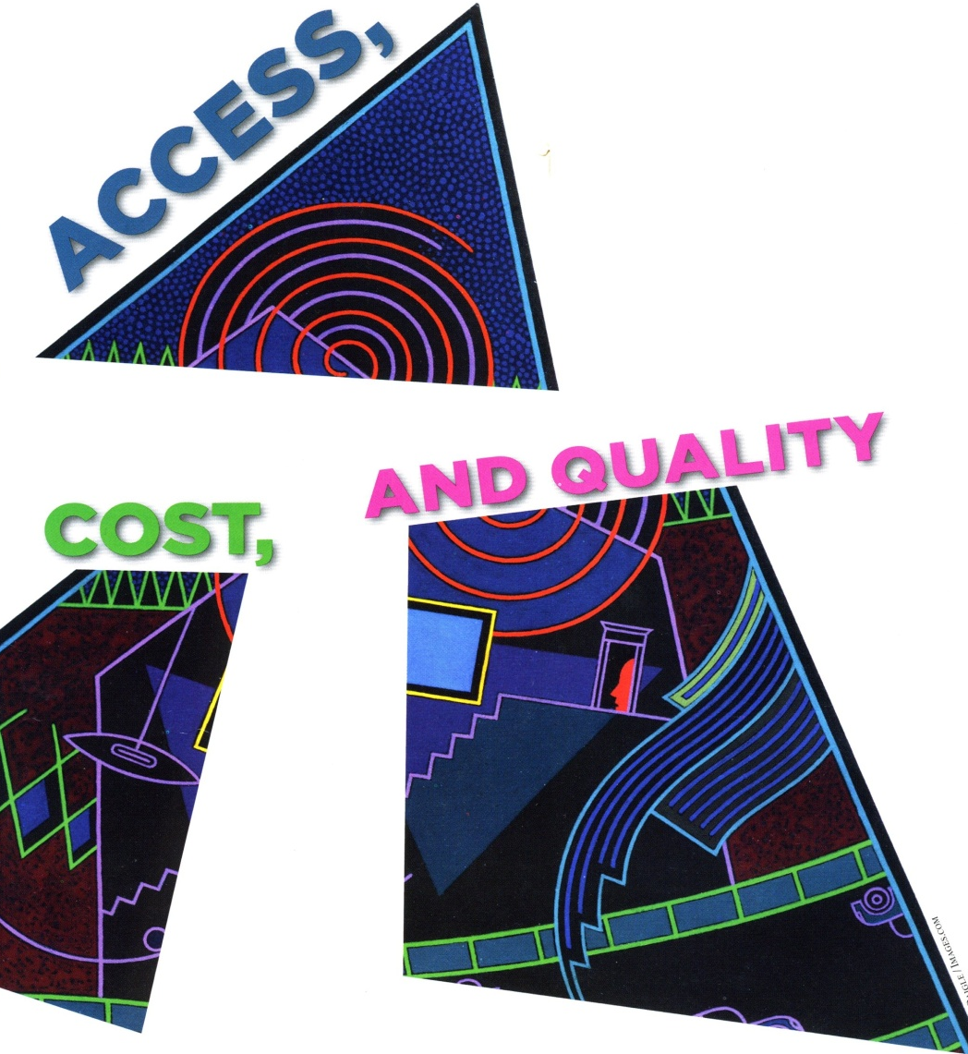
The Deficit in Higher Education
Enrollments in developing countries burgeoning
China and India have doubled enrollments over the past 10 years.
There are many developing countries with APRs less than 10%
Malaysia plans to raise its APR of 39% to 50% by 2010
Trinidad and Tobago aims for an APR of 60% by 2015 (up from 11.9% in 2007)
In India, where each 1% increase in APR means one million more students plans to go from 10% to 15% by 2012
Notes:
The need around the world for expanded education is manifest but in no way can conventional, traditionally delivered higher education meet the demand.
Enrollments in developing countries are burgeoning with over 140 million postsecondary students globally. For example, China and India have doubled enrollments over the past 10 years. China has the largest higher education system in the world, with over 25 million students.
But there are many developing countries with APRs less than 10% and have a big hill to climb. Malaysia plans to raise its APR of 39% to 50% by 2010. The government of Trinidad and Tobago aims for an APR of 60% by 2015 (up from 11.9% in 2007). In India, where each 1% increase in APR means one million more students plans to go from 10% to 15% by 2012.
-Change Magazine, March/April 2009

Slide 9
The Iron Triangle
ACCESS
QUALITY
COST
Notes:
There is what Sir John Daniel calls the “iron triangle” of interrelated elements in which quality is inversely associated with access and cost. Technology at least offers a hope of breaking this relationship.
-Change Magazine, March/April 2009

Slide 10
Institutions Are Being Pushed Toward Greater Attention to Outcome Measurement and Accountability
Notes:
Three states, sponsored by the Lumina Foundation, are modeling the decade-old Bologna Process in an attempt to establish standards that specify what students should know upon graduation. Indiana, Utah, and Minnesota will pilot standards for physics, history, graphic design, and chemistry. (Lewin, 2009). There are reports of a similar trend among Latin American countries, and the Organisation for Economic Co-Operation and Development (OECD) is conducting research and pilots related to cross-national standards. Its Program for International Student Assessment (PISA), Assessment of Higher Education Learning Outcomes (AHELO), and Program for the International Assessment for Adult Competencies (PIAAC) are all ambitious though cautious moves to establish quality standards for outcome-based instruction. (Daniel, 2009).

Slide 11
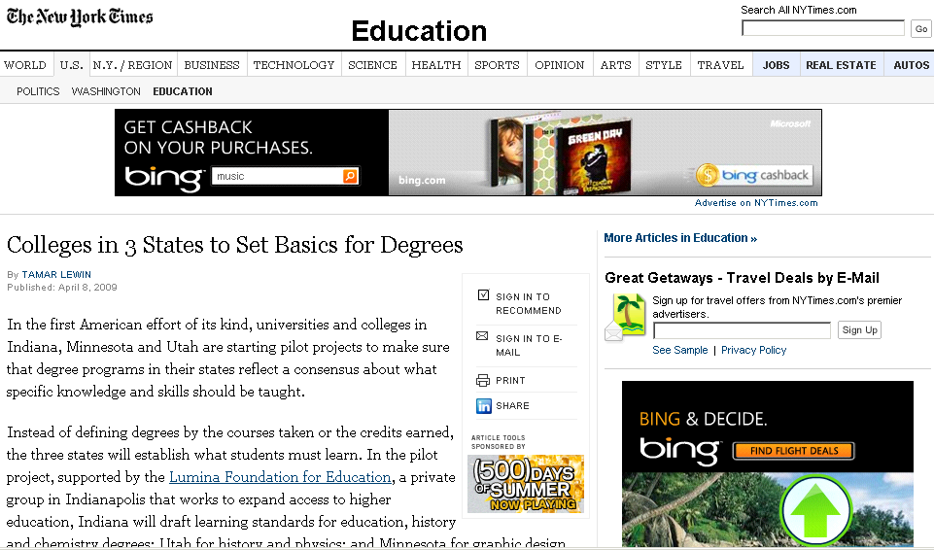

Slide 12
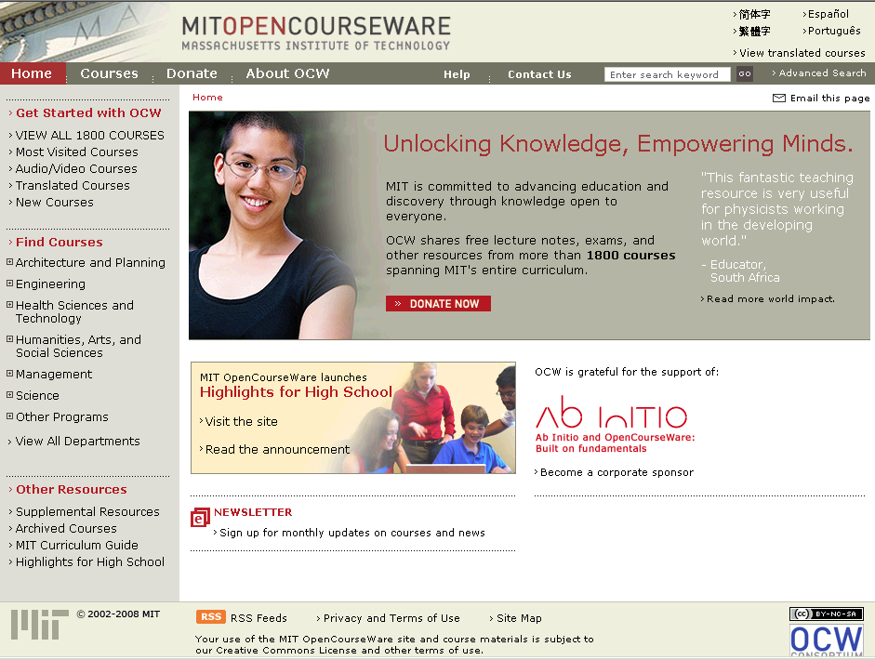
Notes:
MIT was the first university to open the heart of its instructional activities to the world. OpenCourseWare really got started at MIT in 2001. MIT now has 1,900 courses openly available.

Slide 13
MIT’S Most Popular Open Course
Notes:
This is one of MIT’s most popular open courses.
The following slides will show the depth of the content provided on MIT’s OCW Web site.

Slide 14
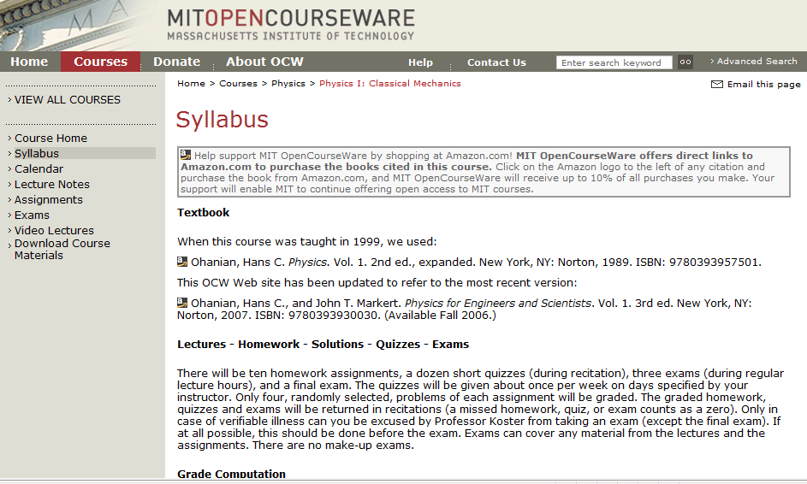
Notes:
This shows the course syllabus.

Slide 15
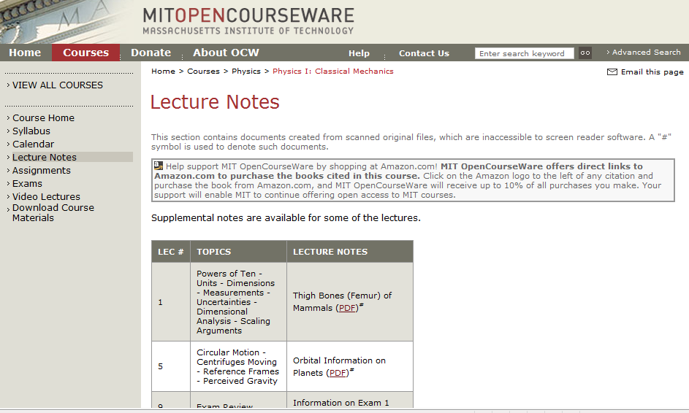
Notes:
This shows the availability of lecture notes.

Slide 16
Notes:
This shows the ability for self-learners to download exams.

Slide 17
For More Information Contact: Gary W. Matkin, Dean, Continuing Education gmatkin@uci.edu or visit http://unex.uci.edu/garymatkin
Notes:
For more information, contact Gary W. Matkin at gmatkin@uci.edu or Kathy Tam at kstam@uci.edu.
You can visit UC Irvine’s Open Courseware site at http://ocw.uci.edu/
For more information about Gary W. Matkin, please visit http://garymatkin

